Slide 1
21CSC305P MACHINE LEARNING PROJECT
Federated Learning for
Shared Models in Hospitals
A three-hospital simulation on the Wisconsin Diagnostic dataset
[Presenter name] [Registration number]
Notes:
Introduce the project as an academic simulation. The goal is to measure what happens when three client datasets have different class distributions while training a shared logistic model. The hospitals are simulated in one process.

Slide 2
Research question
Can three hospitals train one classifier
while keeping training records local?
Classification task
Predict benign or malignant from 30 numeric features.
Experiment
Compare three federated strategies under balanced and class-skewed partitions.
Notes:
Open by distinguishing the supervised task from the federation protocol. The model predicts a benchmark label. The coordinator aggregates parameters and counts. The project simulates three sites and makes no clinical performance or formal privacy claim.

Slide 3
Dataset and leakage prevention
UCI Breast Cancer Wisconsin (Diagnostic)
569
455
114
Public records
Development records
Held-out test records
Split protocol
Reserve a stratified 20% holdout before assigning development records to hospitals.
Feature transform
Apply the same fixed log1p transform at every site. Use local validation during training.
Notes:
Wisconsin Diagnostic features describe cell nuclei in digitized fine-needle aspirate images. The model sees the 30 numeric features. Malignant is positive. Reserve the test set first, then create local training and validation splits. The same fixed log1p feature transform is used across federated clients. Source: https://doi.org/10.24432/C5DW2B and https://scikit-learn.org/1.6/modules/generated/sklearn.datasets.load_breast_cancer.html

Slide 4
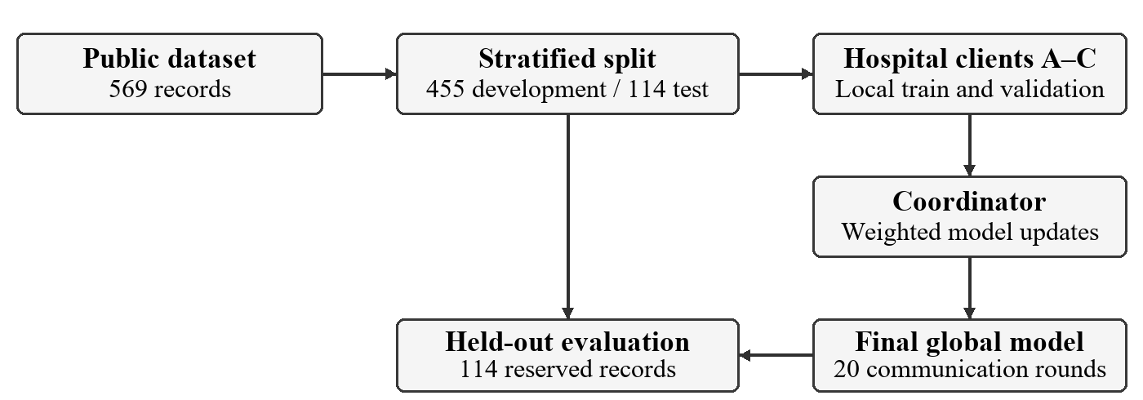
Federated training workflow
Each round starts with shared weights. Clients return model updates and sample counts.
Notes:
At the start of each round, the coordinator broadcasts the current weights. Each hospital trains on its own partition and returns weights or updates plus the optimizer sample count. The coordinator uses weighted aggregation, broadcasts the next model and records pooled local validation. Only the final model is scored on the reserved holdout. Source: project report workflow and implementation.

Slide 5
Class prevalence across hospitals
Malignant share of each hospital’s training records, seed 42
The non-IID partition ranges from 11.7% malignant at Hospital C to 63.8% at Hospital A.
Notes:
In the IID partition, each class is spread approximately evenly across hospitals. Non-IID assigns different class proportions by design. The plot shows training records after the local validation splits, for seed 42. The non-IID malignant counts are 81 of 127, 41 of 116, and 14 of 120. Source: results/stage3/study.json.

Slide 6
Three aggregation strategies
All three strategies use the same PyTorch logistic classifier.
FedAvg
Average local model weights in proportion to each hospital’s training count.
FedProx
Add a local penalty for drifting from the broadcast weights. Then use FedAvg aggregation.
FedAvgM
Accumulate momentum from weighted client updates at the server.
Study settings μ = 0.1 for FedProx β = 0.9 and server learning rate = 1.0 for FedAvgM
Notes:
Let n_k be the number of optimizer training examples on client k and p_k = n_k / sum_j n_j. FedAvg sets w_next to the weighted mean of local weights. FedProx adds (mu/2) times squared distance from the broadcast weights to each local loss and keeps the same averaging rule. FedAvgM computes the weighted client delta, updates velocity as beta times the previous velocity plus delta, and applies the server learning rate. The velocity resets each run. Sources: https://proceedings.mlr.press/v54/mcmahan17a.html, https://arxiv.org/abs/1812.06127, https://arxiv.org/abs/1909.06335.

Slide 7
Experiment design
18 federated runs
Three strategies across IID and non-IID partitions with seeds 42, 43 and 44.
Training budget
20 rounds, 3 local epochs per round, batch size 16 and client learning rate 0.01.
6 centralized runs
Same classifier and matched public training records. Sixty epochs match passes per example.
Shared test set
Final accuracy, precision, recall and F1 on the same 114 cases. Malignant is the positive class.
Notes:
The matrix is 3 strategies × 2 partition modes × 3 seeds, plus one centralized reference per mode and seed. Each strategy within a mode and seed uses the same training assignment, initialization and minibatch seed schedule. The centralized reference uses the matched pooled public training examples, 60 epochs and the same model, transform, learning rate and batch size. Its minibatch order differs. The study held the benchmark split fixed across all seeds. Source: ml-engine/configs/study.json and results/stage3/study.json.

Slide 8
Held-out performance
Mean ± sample standard deviation across three seeds
Strategy | IID accuracy | IID F1 | Non-IID accuracy | Non-IID F1
FedAvg | 76.9% ± 4.8 pp | 0.549 ± 0.157 | 71.6% ± 9.6 pp | 0.334 ± 0.338
FedProx | 76.9% ± 4.8 pp | 0.549 ± 0.157 | 71.6% ± 9.6 pp | 0.334 ± 0.338
FedAvgM | 83.3% ± 0.9 pp | 0.732 ± 0.010 | 79.8% ± 4.4 pp | 0.622 ± 0.121
Centralized logistic | 84.8% ± 2.7 pp | 0.774 ± 0.058 | 83.9% ± 1.0 pp | 0.758 ± 0.033
FedAvgM achieved the highest mean federated F1 in both partitions.
Mean F1 decreased under class skew for all three federated strategies.
Notes:
Each entry is the mean and sample standard deviation across the three run seeds. Accuracy dispersion is in percentage points. The shared holdout makes comparisons consistent, but the seeds do not give independent test cohorts. At mu=0.1, FedProx and FedAvg obtained the same reported classification scores. The centralized logistic baseline had the highest mean F1. Source: results/stage3/summary.csv.

Slide 9
Validation loss over communication rounds
Non-IID partition, mean across three seeds
FedAvgM fluctuated early and finished with the lowest mean validation loss.
Notes:
This plot averages the pooled local validation loss over the three seeds for the non-IID runs. These are validation measurements taken after each broadcast, not the final test metrics. FedAvgM fluctuates early and ends at a lower mean loss. FedAvg and FedProx largely overlap in this setting. Source: results/stage3/study.json, each run’s history.

Slide 10
Communication and verification
232,839 bytes
Serialized model transfer per 20-round federated run
Upload and download
113,580 bytes uploaded. 119,259 bytes downloaded, including the initial broadcast.
Verification
19 Python tests and 3 Java integration tests passed. The MySQL and browser smoke tests completed real runs.
Simulated payload totals exclude transport overhead.
Notes:
The communication estimate uses serialized model-state sizes, including one initial download to each hospital and one upload and download per hospital per round. It excludes network overhead and validation summaries. Verification included 19 Python tests and three Java integration tests. The live MySQL test verified completion, exports and run persistence after restart. Source: results/stage3/runs.csv and project test results.

Slide 11
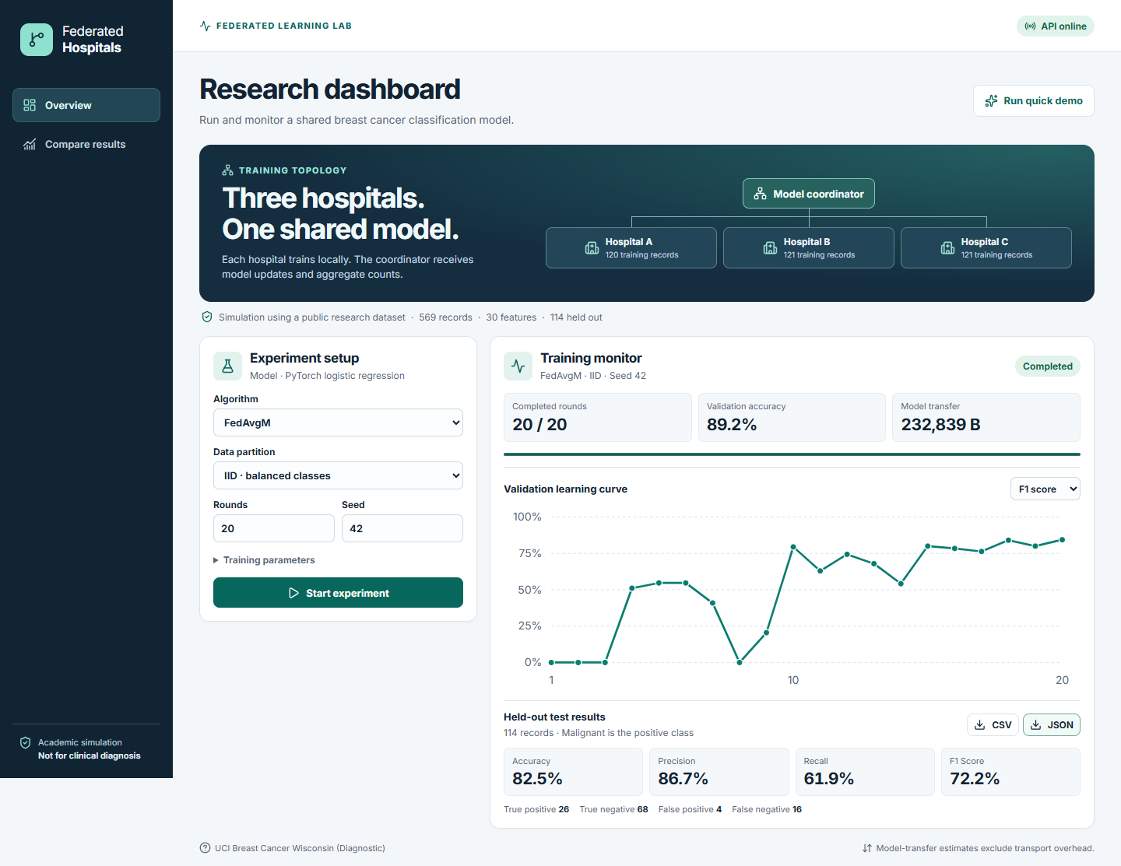
Dashboard demonstration
20 / 20 rounds
IID FedAvgM, seed 42
82.5% test accuracy
72.2% test F1
React monitors the Spring Boot API. Python trains the models and MySQL stores aggregate run metadata.
Notes:
If presenting live, start MySQL, Spring Boot and the Vite preview before the session. Open http://127.0.0.1:4173, wait for API online, then select Run quick demo. Switch the validation chart to F1 and point out the final scores and CSV/JSON downloads. This screenshot is a fallback from the completed 20-round FedAvgM seed-42 demo. Source: docs/screenshots/dashboard.png.

Slide 12
Conclusions and limits
Main finding
FedAvgM led the federated strategies on mean F1. Class skew reduced F1 for every federated strategy.
Evidence boundary
One public dataset, one shared holdout, three seeds and three simulated hospitals.
Data locality
Training records stay with simulated clients. Shared updates can still reveal information.
Next experiment
Vary skew severity and momentum settings. Evaluate on independent data with isolated clients.
Notes:
The findings apply to the chosen model, optimizer settings and benchmark. The experiment measured class skew in three simulated hospitals. It did not establish clinical validity or formal privacy. Next steps include multiple independent cohorts, a wider skew and hyperparameter sweep, and isolated hospital processes. Model updates can still leak information. Source for privacy caveat: https://proceedings.mlr.press/v202/zhu23m.html.

Slide 13
References and questions
Dataset
Wolberg, Mangasarian and Street. Breast Cancer Wisconsin (Diagnostic).
doi.org/10.24432/C5DW2B
FedAvg
McMahan et al. Communication-Efficient Learning of Deep Networks from Decentralized Data. 2017.
proceedings.mlr.press/v54/mcmahan17a.html
FedProx
Li et al. Federated Optimization in Heterogeneous Networks. 2020.
arxiv.org/abs/1812.06127
FedAvgM
Hsu, Qi and Brown. Measuring the Effects of Non-Identical Data Distribution for Federated Visual Classification. 2019.
arxiv.org/abs/1909.06335
Notes:
If asked which result is strongest, cite the controlled comparison and its limits. If asked why a centralized reference was included, explain that it measures performance with matched training examples and a pooled public-data workflow. Sources are listed on this slide.

